Slide 1
Learningfield 9
Providing Networks and Services
by Amy M. Hengstmann (IT3L, Group 14)

Slide 2
Contents
The Old Network (IPv4)
The New Network (IPv6) Part 1
IPAM
VLAN Overview
Port Allocation Plan
Transport networks (Router Interconnections)
Example for Static Routes (per Router)
Toplogy Diagram (Textual)
API

Slide 3
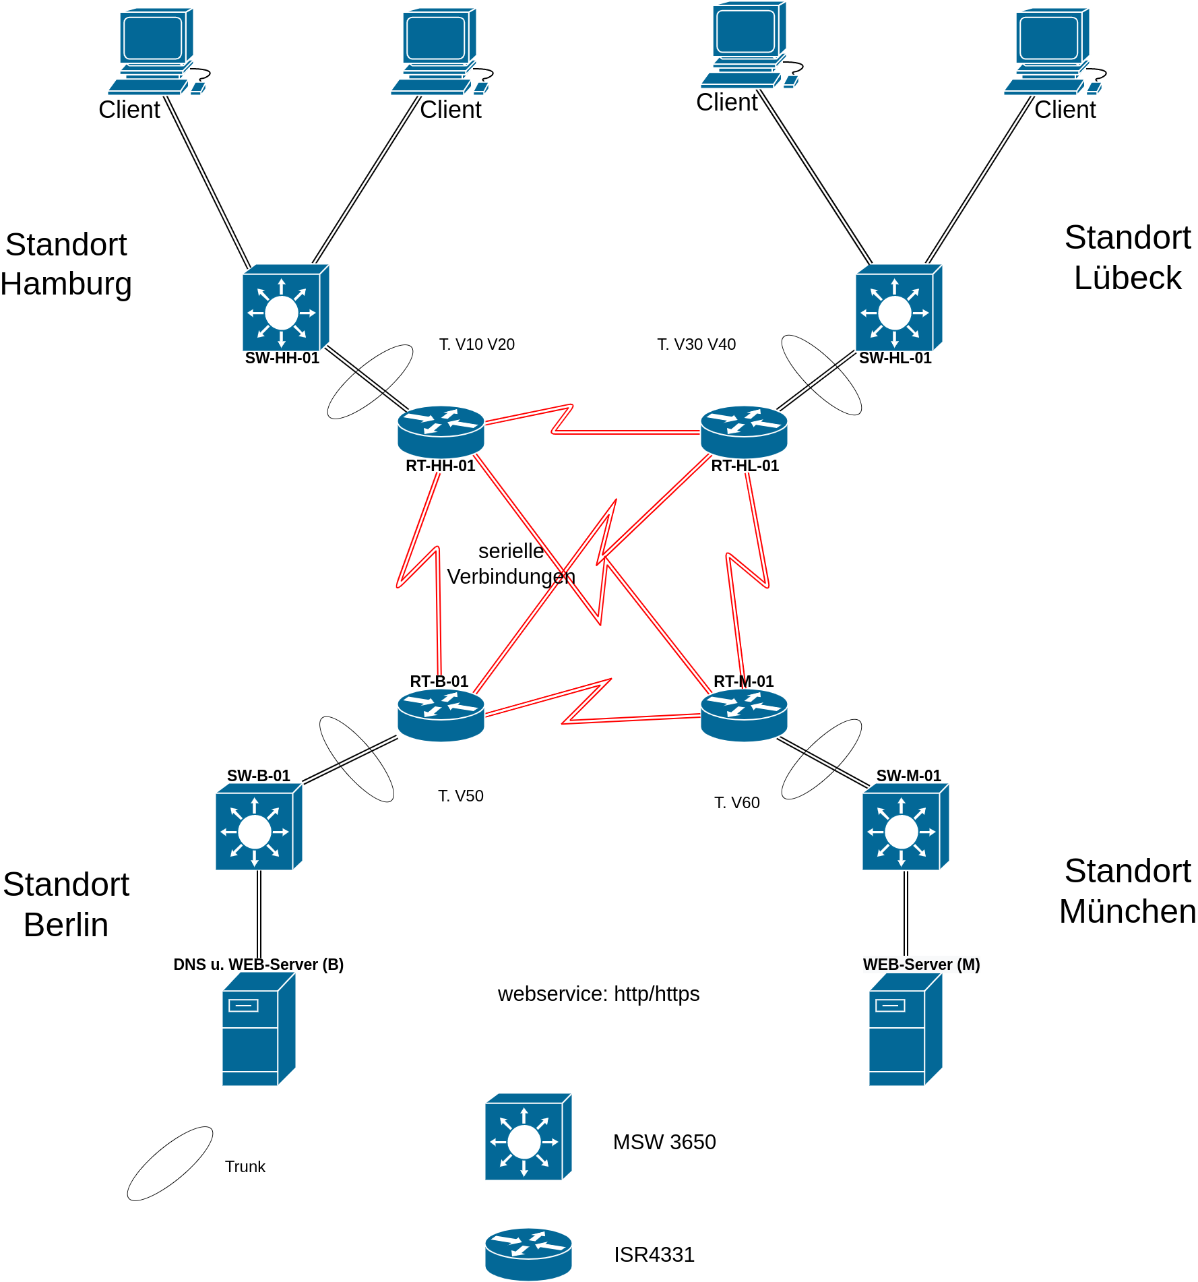

The Old Network (Ipv4)
Streamline, Hamburg, founded in 2019
Other locations in Lübeck, Berlin und München
IPv4 and NAT

Slide 4
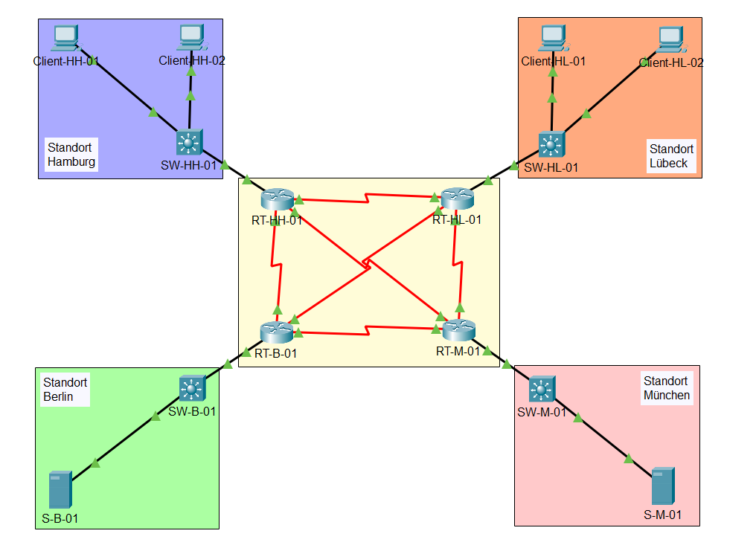
The New Network (IPv6)
All infrastructure uses IPv6 only, no dual-stack.
Transport networks use Unique Local Addresses (fd00::/8).
Site VLANs use Global Unicast Addresses (2001:db8::/32).
All routing is done with static routes.

Slide 5
IPAM (IP Adress Management)
Location | VLAN | Subnet (Prefix) | Gateway (SVI) | Switch Uplink | Router Uplink
Hamburg (HH) | VLAN10 | 2001:db8:1::/64 | 2001:db8:1::1 | fd00:1::1 | fd00:1::2
 | VLAN20 | 2001:db8:2::/64 | 2001:db8:2::1 | fd00:1::1 | fd00:1::2
Lübeck (HL) | VLAN30 | 2001:db8:3::/64 | 2001:db8:3::1 | fd00:1::3 | fd00:1::4
 | VLAN40 | 2001:db8:4::/64 | 2001:db8:4::1 | fd00:1::3 | fd00:1::4
Berlin (B) | VLAN50 | 2001:db8:5::/64 | 2001:db8:5::1 | fd00:1::5 | fd00:1::6
Munich (M) | VLAN60 | 2001:db8:6::/64 | 2001:db8:6::1 | fd00:1::7 | fd00:1::8

Slide 6
VLAN Overview
VLAN ID | Purpose | Subnet | Gateway
VLAN10 | Client-HH-01 | 2001:db8:1::/64 | 2001:db8:1::1
VLAN20 | Client-HH-02 | 2001:db8:2::/64 | 2001:db8:2::1
VLAN30 | Client-HL-01 | 2001:db8:3::/64 | 2001:db8:3::1
VLAN40 | Client-HL-02 | 2001:db8:4::/64 | 2001:db8:4::1
VLAN50 | S-B-01 | 2001:db8:5::/64 | 2001:db8:5::1
VLAN60 | S-M-01 | 2001:db8:6::/64 | 2001:db8:6::1

Slide 7
Port Allocation Plan
Device | Interface | Purpose | IP Address
Switch HH | G1/0/3 | Uplink to Router | fd00:1::1
Router HH | G0/0/0 | Uplink to Switch | fd00:1::2
Switch HL | G1/0/3 | Uplink to Router | fd00:1::3
Router HL | G0/0/0 | Uplink to Switch | fd00:1::4
Switch B | G1/0/2 | Uplink to Router | fd00:1::5
Router B | G0/0/0 | Uplink to Switch | fd00:1::6
Switch M | G1/0/2 | Uplink to Router | fd00:1::7
Router M | G0/0/0 | Uplink to Switch | fd00:1::8
All other switch ports are assigned to their respective VLANs for end devices (PCs / Servers)

Slide 8
Transport Networks (Router Interconnections)
Link | Subnet | RT-HH Interface | Other Router Interface
HH–HL | fd00:2::/64 | S0/1/0 (fd00:2::1) | HL: S0/1/0 (fd00:2::2)
HH–B | fd00:3::/64 | S0/1/1 (fd00:3::1) | B: S0/1/0 (fd00:3::2)
HH–M | fd00:4::/64 | S0/2/0 (fd00:4::1) | M: S0/1/0 (fd00:4::2)
HL–B | fd00:5::/64 | S0/1/1 (fd00:5::1) | B: S0/1/1 (fd00:5::2)
HL–M | fd00:6::/64 | S0/2/0 (fd00:6::1) | M: S0/1/1 (fd00:6::2)
B–M | fd00:7::/64 | S0/2/0 (fd00:7::1) | M: S0/2/1 (fd00:7::2)

Slide 9
Static Routes (per Router)
Each router has:
Static routes for its local VLAN(s) via the local switch uplink IP.
Static routes for remote VLANs via the next-hop router interface on the transport network.
Example for RT-HH-01: ipv6 route 2001:db8:1::/64 fd00:1::1 ipv6 route 2001:db8:2::/64 fd00:1::1 ipv6 route 2001:db8:3::/64 fd00:2::2 ipv6 route 2001:db8:4::/64 fd00:2::2 ipv6 route 2001:db8:5::/64 fd00:3::2 ipv6 route 2001:db8:6::/64 fd00:4::2

